Slide 1


Arab Academy For Science, Technology and Maritime Transport
College of Computing and Information Technology – Cairo
Warsha
A centralized digital platform connecting local residents with verified service providers
Course: Introduction to Software Engineering (CSE2001)
12th Week Project Documentation
Team Members:
Abdulrahman Ahmed (241004780) | Marino Remon (241004796)
Mohamed Mahmoud (241005267) | Seif Bakry (241004799)
Presented To:
Dr. Eman ElSayed Mahmoud
Eng. Anas Ahmad Ibraheem

Slide 2
Agenda
Introduction – Overview of the Warsha platform
Problem Statement – Challenges in finding reliable local services
Project Goals – High-level outcomes of the project
Project Objectives – Specific and measurable targets
Functional Requirements – System features and capabilities
Non-Functional Requirements – Performance, security, and quality
UML Design – Use Case, Activity, Sequence, State Machine, Misuse Case, Class
Implementation – Implemented functions and screenshots
Conclusion and Summary – Key takeaways

Slide 3
Introduction
Warsha is a centralized digital platform that connects local residents with verified service providers such as plumbers, tutors, and electricians.
What the system is about:
A standalone platform with mobile apps (Android & iOS) and a web application
Connects three primary user classes: Customers, Workers, and Administrators
Handles authentication, service discovery, scheduling, payments, and disputes
Why this project is important:
Centralized service access – one platform for all local services
Trust and transparency through ratings, reviews, and verified worker profiles
Organized booking system with in-app scheduling and payment
Support for local professionals to reach more customers digitally

Slide 4
Problem Statement
Many people struggle to find reliable local services due to the lack of organized platforms. The key issues include:
Scattered Service Providers – Service providers are difficult to find because they operate across different platforms or offline sources
Limited Provider Information – Customers usually have little information about a provider's quality or reliability
Difficulty Comparing Services – Without a structured platform, comparing providers based on price or quality is difficult
Inefficient Communication – Traditional communication methods make scheduling and managing services slower
Limited Visibility for Workers – Many skilled workers cannot easily reach potential customers without an online presence

Slide 5
Project Goals
The primary goal of Warsha is to develop a centralized, user-friendly digital platform that connects local residents with verified service providers.
Key Goals:
Bridge the gap between community needs and local expertise
Foster local economic growth by giving workers a digital presence
Simplify the search for reliable help through organized service categories
Build trust between customers and providers through ratings and verification
Streamline the entire service lifecycle – from discovery to payment

Slide 6
Project Objectives
1. User-Centric Interface – Separate registration flows for Customers and Providers; cross-platform (Android, iOS, Web)
2. Advanced Search & Discovery – GPS map-based search; organized categories with price/rating filters
3. Trust & Transparency – Rating/feedback mechanism; admin verification of credentials (licenses/IDs)
4. Communication & Booking – In-app chat; time slot booking; provider availability dashboard
5. Data Integrity – Encrypted payment gateways; scalable database for growing users and listings

Slide 7
Functional Requirements – Account & Profile
Account Management
(Priority: High)
FR1 – Customers can create an account
FR2 – Workers can create an account
FR3 – Users can log in with credentials
FR4 – Users can edit profile info
Key Flows:
Sign Up → role selection → registration form → account creation
Log In → authentication → dashboard redirect
Profile → editable information display
Worker Profile Management (Priority: High)
FR5 – Enter personal/professional details
FR6 – Specify services offered
FR7 – Define preferences (travel, availability)
FR8 – Configure base pricing
Key Flows:
Profile setup → details forms
Service selection → update categories
Preferences → save settings
Pricing → store base pricing

Slide 8
Functional Requirements – Discovery & Booking
Service Discovery
(Priority: High)
FR9 – Browse available services
FR10 – Search for workers
FR11 – View worker profiles and ratings
FR12 – GPS-based nearest worker display
Key Flows:
Open app → service categories displayed
Search query → matching workers returned
Select worker → profile with ratings shown
Enable location → nearest workers on map
Appointment Booking (Priority: High)
FR13 – Book appointments
FR14 – Select date and time
FR15 – Verify availability
FR16 – Cancel/reschedule
FR17 – Accept/reject requests
FR18 – View scheduled appointments
FR19 – Mark jobs completed
Key Flows:
Select service → time slots shown
Confirm → appointment created
Complete → rating enabled

Slide 9
Functional Requirements – Payment & Admin
Payment Processing
(Priority: High)
FR20 – In-app payments for services
FR21 – Credit card or cash payment
FR22 – Coupon/discount application
FR23 – Store payment transactions
FR24 – Submit refund requests
FR25 – View earnings and history
FR26 – Withdraw earnings
Reviews & Ratings
(Priority: Medium)
FR27 – Rate workers after service
FR28 – Display ratings on profiles
Admin Management (Priority: High)
FR29 – Approve/reject registrations
FR30 – Suspend/reactivate accounts
FR31 – Manage and resolve disputes
FR32 – Review and process refunds
Key Flows:
Registration → review → approve/reject
Violation → suspend/reactivate
Dispute → review → resolve
Refund → review → process
Rules:
Verify before accepting
Ratings after completion
Refunds within 48h
One account per person

Slide 10
Non-Functional Requirements
Performance (NFR-PERF)
Pages load within 3s
500+ concurrent users
DB queries within 1s
Payments within 5s
Safety (NFR-SAF)
Protect contact info
Warnings on irreversible actions
Secure document storage
Role-based access control
Security (NFR-SEC)
HTTPS/TLS encryption
Authentication required
Admin action logging
Secure password policies
PCI-DSS compliance
SQL/XSS/CSRF protection
Business Rules
Verify before accepting
Ratings after completion
Refunds within 48h
One coupon per transaction
One account per person
Quality Attributes
Usability – Under 3 min registration
Scalability – Grow without rework
Availability – 99% uptime
Reliability – Data integrity
Maintainability – Well-documented
Portability – Expand platforms
Testability – Unit, integration, E2E

Slide 11
UML Design Overview
The Warsha system is modeled using six UML diagram types:
Use Case Diagram – Interactions between Customer, Worker, Admin and the system
Activity Diagram – Service booking workflow from search to rating
Sequence Diagram – Interaction sequence during booking and payment
State Machine Diagram – Lifecycle states of Appointment and Worker Registration
Misuse Case Diagram – Security threats and mitigation strategies
Class Diagram – Static structure: User, Customer, Worker, Admin, Service, Appointment, Payment, Review

Slide 12
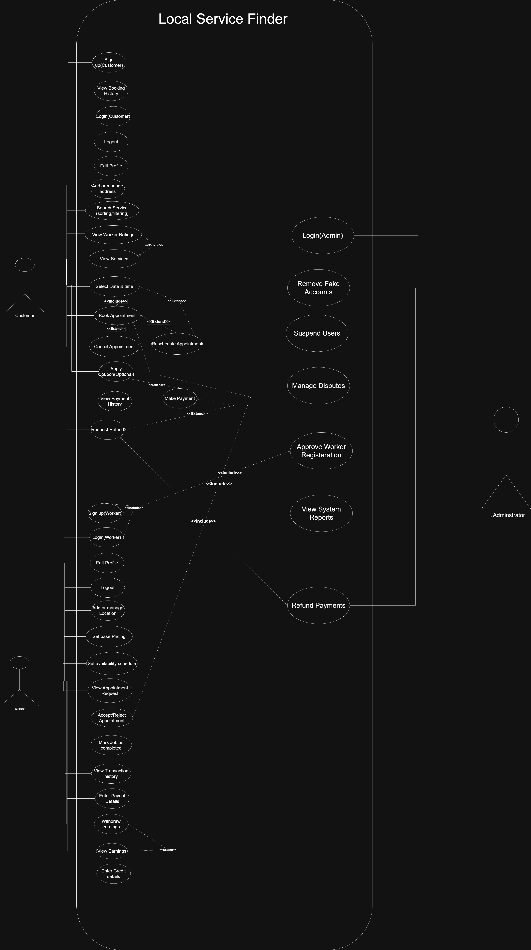
Use Case Diagram

Slide 13
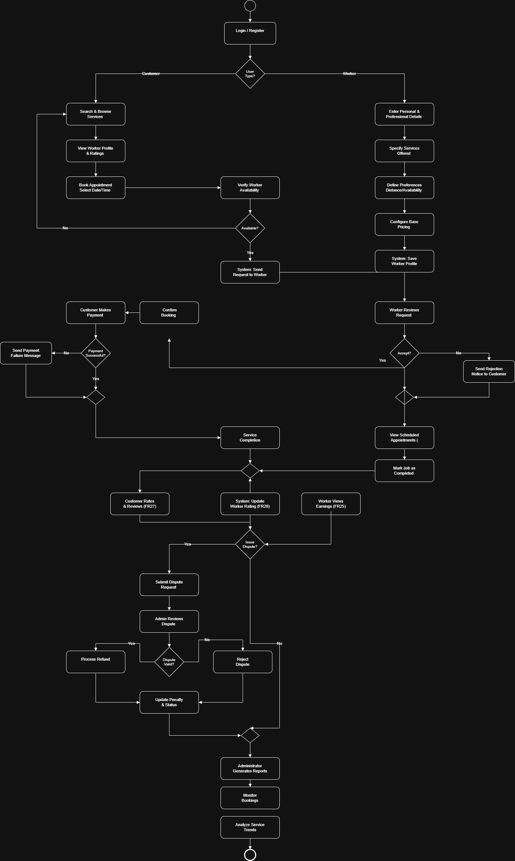
Activity Diagram

Slide 14
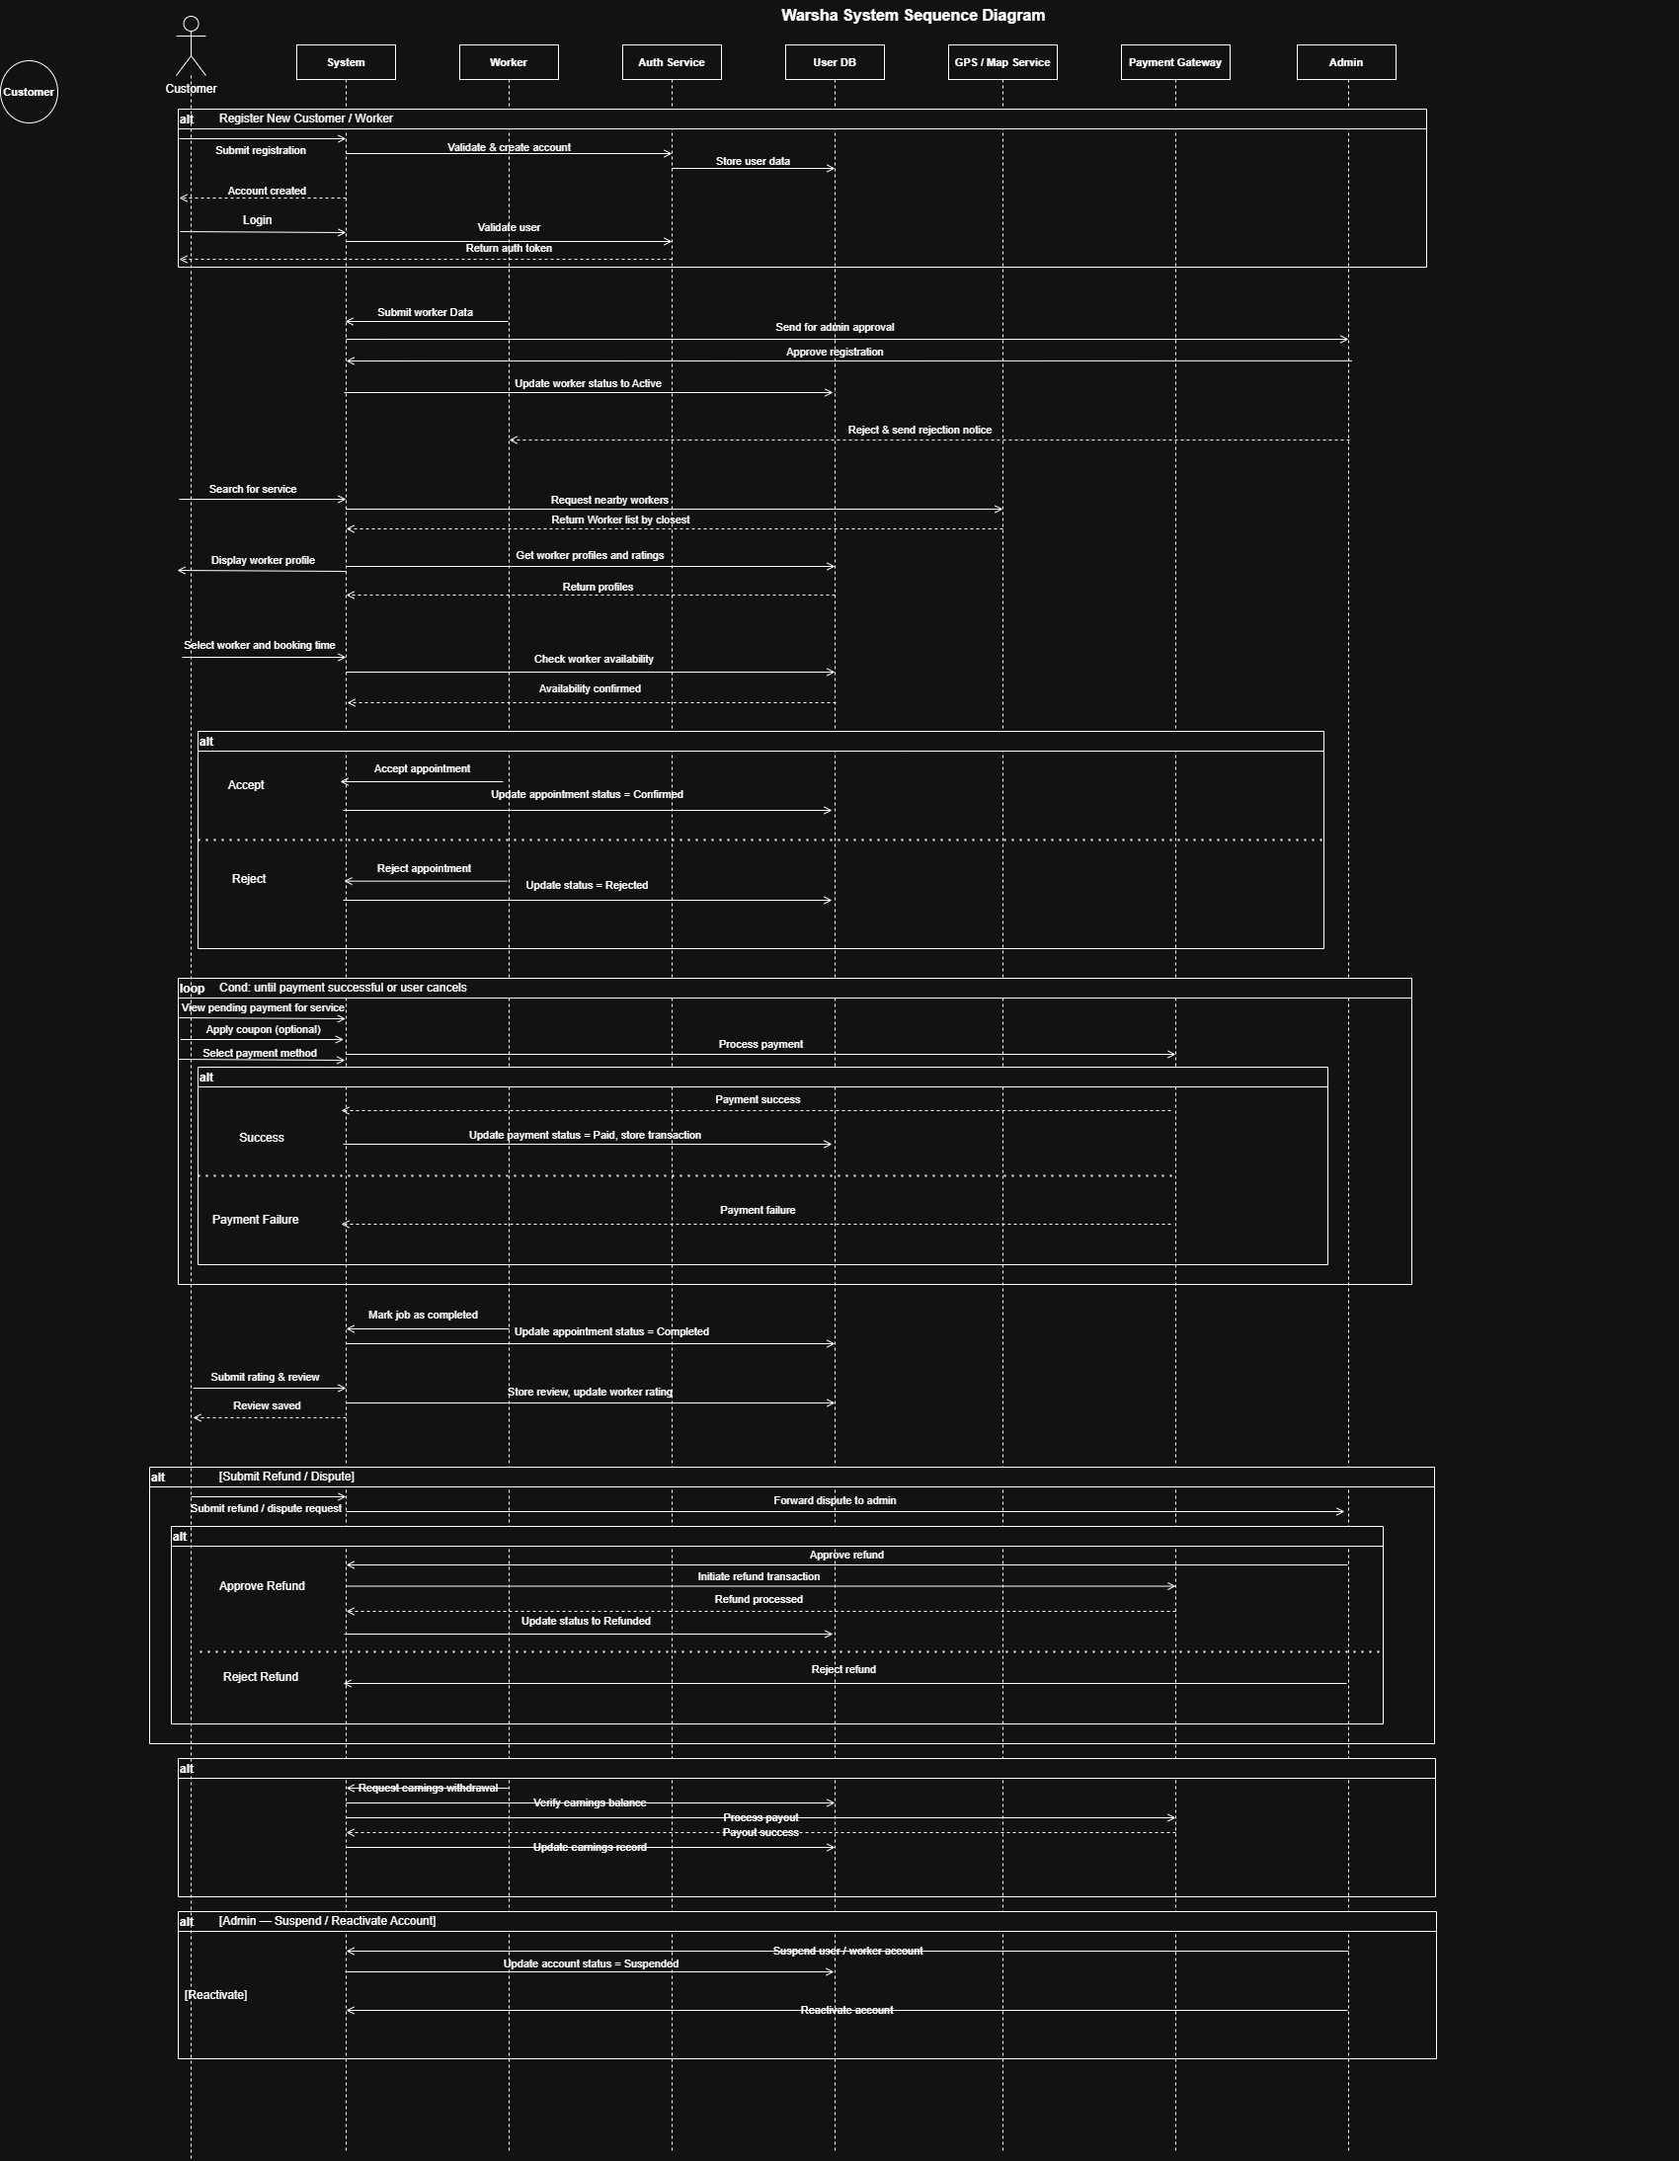
Sequence Diagram

Slide 15
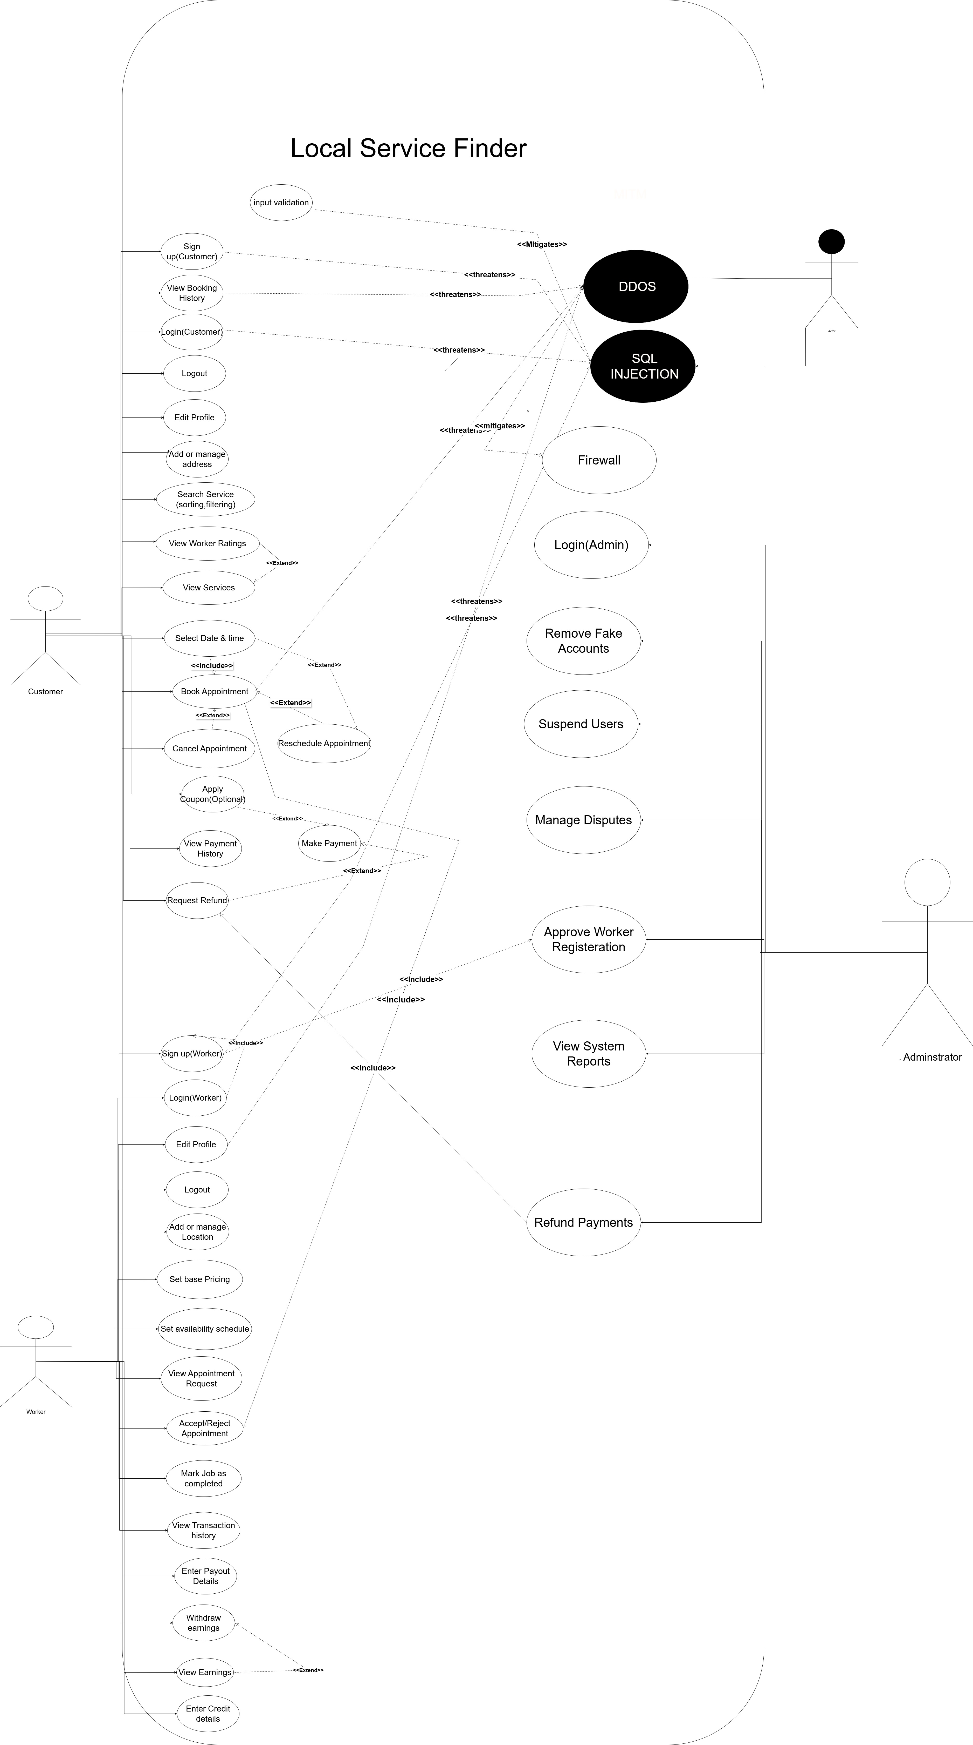
Misuse Case Diagram

Slide 16
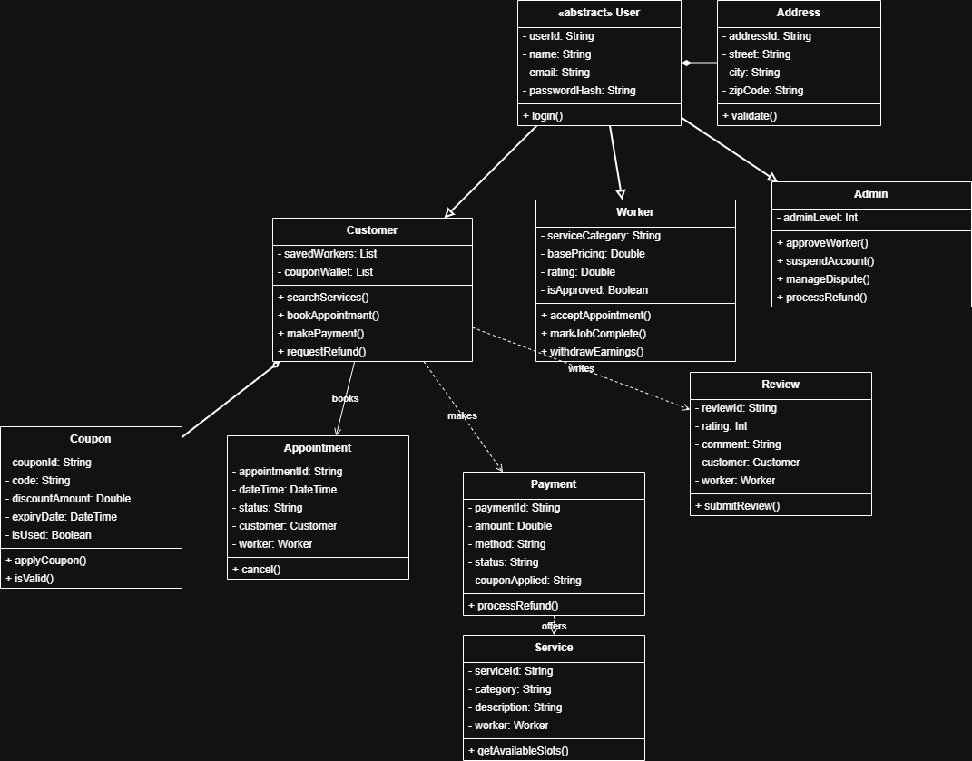
Class Diagram

Slide 17
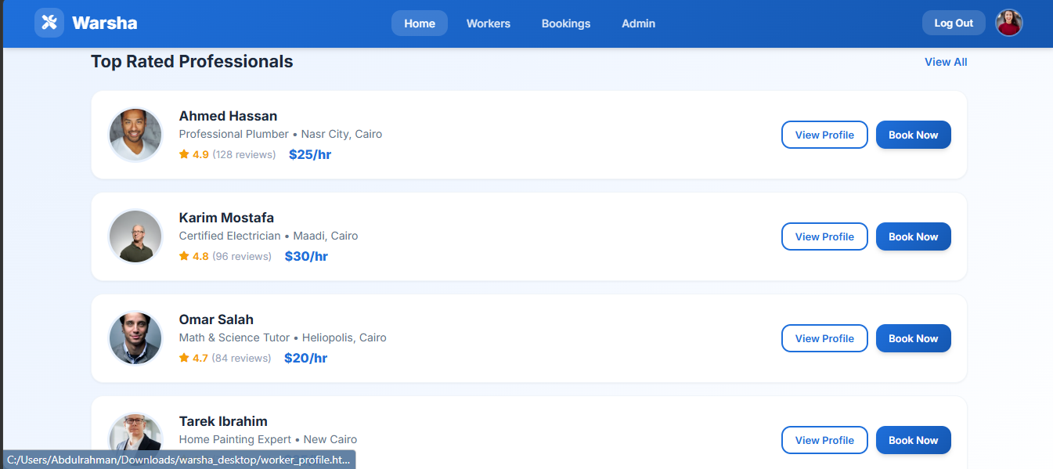
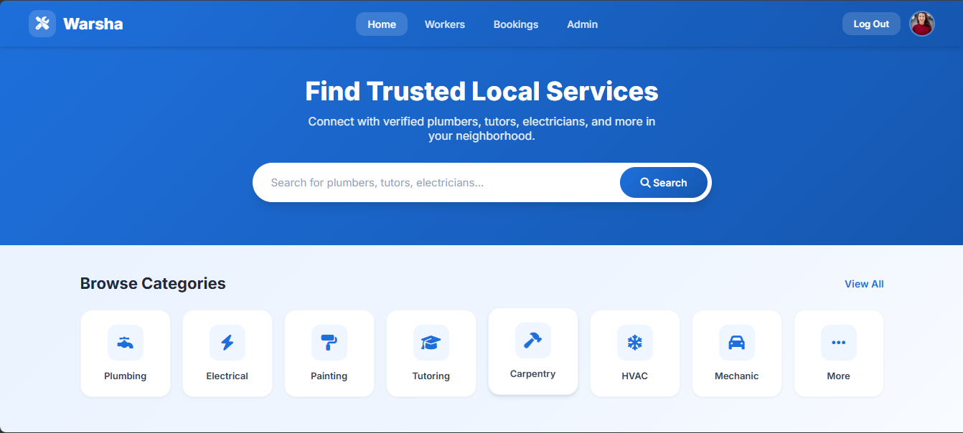
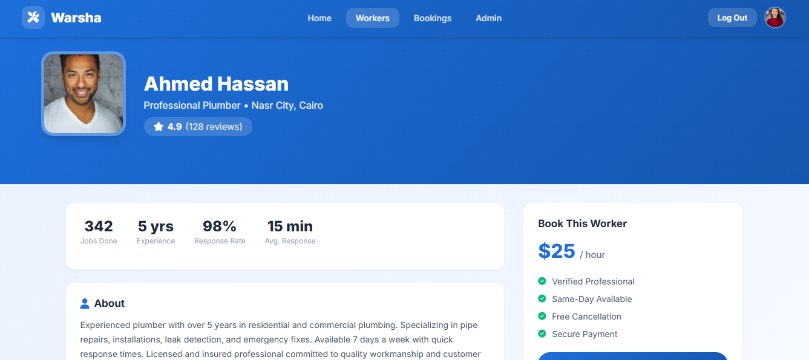
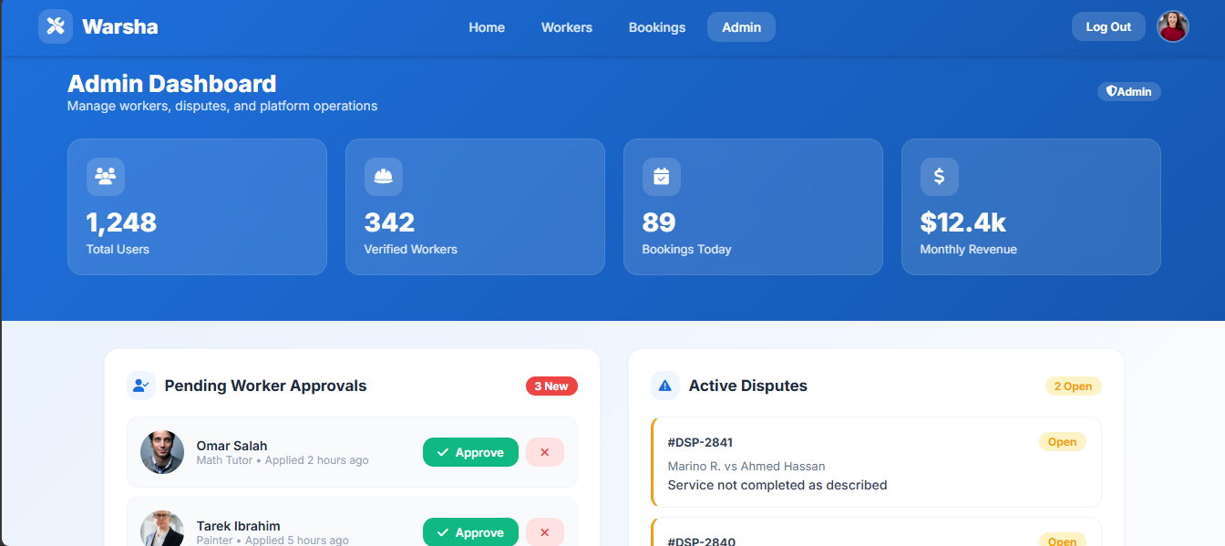
Implementation

Slide 18
Conclusion and Summary
Project Recap: Warsha bridges the gap between local service seekers and verified providers.
Achievements:
Centralized digital marketplace
Verified worker profiles with admin oversight
Streamlined booking, payment, and rating
Trust through ratings and verification
Admin dashboard for disputes/refunds
Key Takeaways:
IEEE 830-1998 compliant SRS
32 functional requirements, 7 feature areas
Comprehensive NFRs across all categories
Complete UML design (6 diagram types)
Clear in-scope and out-of-scope definition

Slide 19
Thank You
Questions?
Warsha Team
Abdulrahman Ahmed | Marino Remon | Mohamed Mahmoud | Seif Bakry

